Slide 1







Microsoft
Corporation, Inc.
Presented by-
Vanshika Soni
Piyush Upadhyay
Tejaswini Chauhan
Lucky Verma

Slide 2


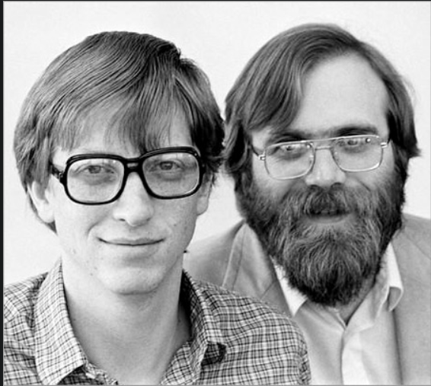

How it all started?
Dream of having a PC on every desk

Slide 3


Microsoft Corporation
Microsoft Corporation is an American multinational technology corporation headquartered in Redmond, Washington.
The Company was founded by Bill Gates and Paul Allen on April 4, 1975.
Develops, manufactures, licenses, and supports a wide range of products and services.

Slide 4












HISTORY
1975
1983
1985
1989
1990
They sell basic, the first PC computer language program to MITS Computer, Microsoft first customer
Paul Allen resigned as executive vice-president but remained on the board: Jon Shirley is made president of Microsoft (he later became CEO).
Microsoft and IBM Forge a joint development agreement. They launched Windows 1.0 (the first window-based OS).
Microsoft co-develop SQL server 1.0
Jon Shirley retires as president and CEO, Michael R. Hallman is promoted in Shirley’s place.

Slide 5




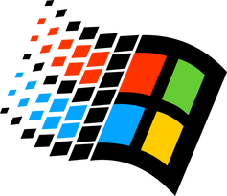


HISTORY
1992
1994
1995
1998
2000
The company introduced Windows 3.1. Windows now has over 25 million licensed users
In this year Microsoft released Windows NT.
In 1995 Microsoft launched Windows 95.
The US Department of Justice filed two antitrust cases against Microsoft, alleging the company had Sherman Act.
First beta of .NET framework released.

Slide 6






HISTORY
2001
2003
2004
2005
2007
Microsoft Windows XP is released internationally
Microsoft launches windows server
Microsoft announces a five-country pilot program for Windows XP starter edition.
MSN launched a new Search service available in 25 markets and 10 languages
Windows Vista was released to consumers along with a new version of its office suite, called Microsoft office 2007.

Slide 7



Use of Technology with in Microsoft

Slide 8

Azure Machine Learning:
Azure ML Studio: A cloud-based integrated development environment for building, training, and deploying machine learning models.
Azure ML Services: A comprehensive set of services for end-to-end machine learning workflows, including model training, deployment, and management.

Slide 9
Project Bonsai
Project Bonsai is a tool offered by Microsoft that allows developers with little or no AI experience to design and train an AI agent to do various tasks. It is a ‘machine teaching’ tool. These tasks could be to advise a human operator or to optimise industrial process variables to improve production efficiency.

Slide 10

Microsoft Power BI is an interactive data visualization software product developed by Microsoft with a primary focus on business intelligence. It is part of the Microsoft Power Platform. Power BI is a collection of software services, apps, and connectors that work together to turn various sources of data into static and interactive data visualizations.

Slide 11

Project Brainwave
Project Brainwave is a deep learning platform for real-time AI inference in the cloud and on the edge.
A soft Neural Processing Unit (NPU), based on a high-performance accelerates deep neural network (DNN) inferencing, with applications in computer vision and natural language processing.
Project Brainwave is transforming computing by augmenting CPUs with an interconnected and configurable compute layer composed of programmable silicon.

Slide 12
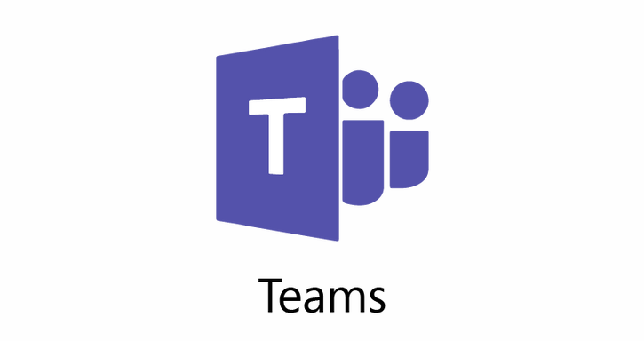


Some popular tools provided by Microsoft
Microsoft Teams
One Drive
Power Point
Ultimate messaging app for your organization—a workspace for real-time collaboration and communication, meetings, file and app sharing, and even the occasional emoji!
Use OneDrive to save documents, photos, and other files in the cloud, share them with friends, and even collaborate on content.
Microsoft PowerPoint is a powerful slide show presentation program. It is a standard component of the company's Microsoft Office suite software

Slide 13

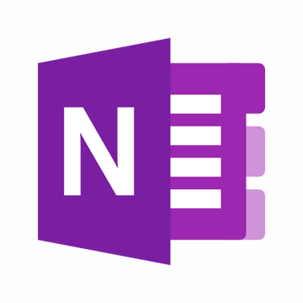
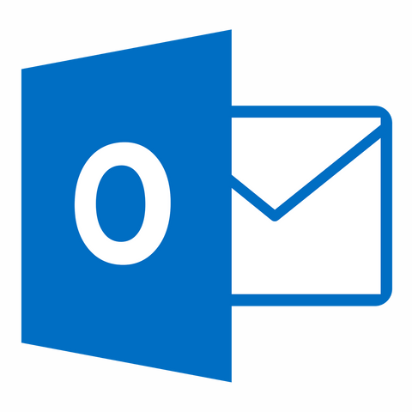


Some popular tools provided by Microsoft
One Note
Outlook
MS Word
Outlook allows you to send and receive email messages, manage your calendar, store names and numbers of your contacts, and track your tasks.
Word is a word processing program that allows for the creation of both simple and complex documents. With Office 365, you are able to download the application to your hard drive and will also have access to the online version
OneNote is a digital note-taking app that provides a single place for keeping all of your notes, research, plans, and information

Slide 14


Comparative Analysis
With Other Companies

Slide 15


Google is a strong competitor for Microsoft as they both compete in the enterprise solutions vertical. Google has its G Suite platform that includes apps like Gmail, Docs, and Drive, similar to Office 365. Windows dominates the market with a 73 percent market share, followed by Google Chrome at 10.8 percent and Mac OS with 7.5 percent, according to data from Statista. However, in the Search Engine market, Google holds the largest market share with 88.52 percent, followed by Microsoft’s Bing at 5.63 percent.
Microsoft and Amazon compete in the Cloud segment with their respective offerings. It’s a fierce battle between Microsoft Azure and Amazon Web Services (AWS) as both works towards maintaining their dominance in this vertical. Microsoft faces a threat from Amazon Web Services’ (AWS) rapid development and expansion in the cloud services market due to its large customer base and low prices.The Cloud Infrastructure Service market share of Amazon Web Services (AWS) and Microsoft is at 31 percent and 22 percent.

Slide 16


Microsoft competes against Apple in the enterprise solutions, hardware, and mobile operating system market. The competition has intensified as both are trying to strengthen their hold on different markets. The company aims to provide its users with seamless communication across different Apple devices and constantly adds new features to improve productivity. Apple’s iOS mobile operating system controlled 16.55 percent of the mobile operating system market share, whereas Microsoft Windows had a 30.2 percent market share.
IBM is among the world’s leading enterprise cloud providers and has adopted a hybrid approach to data services. The company aims to deliver its solutions through multiple channels such as cloud-based offerings, on-premise solutions, and hybrid cloud platforms. Microsoft identifies IBM as a competitor in the artificial intelligence (AI) market due to its Cognitive Services offering, database, and business intelligence products. Microsoft held the largest market share in IaaS Cloud Services with 15.5 percent, while IBM lagged with 1.8 percent.

Slide 17
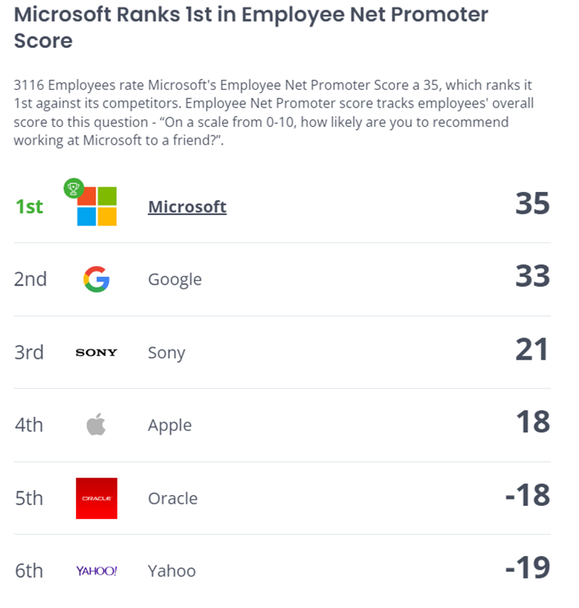
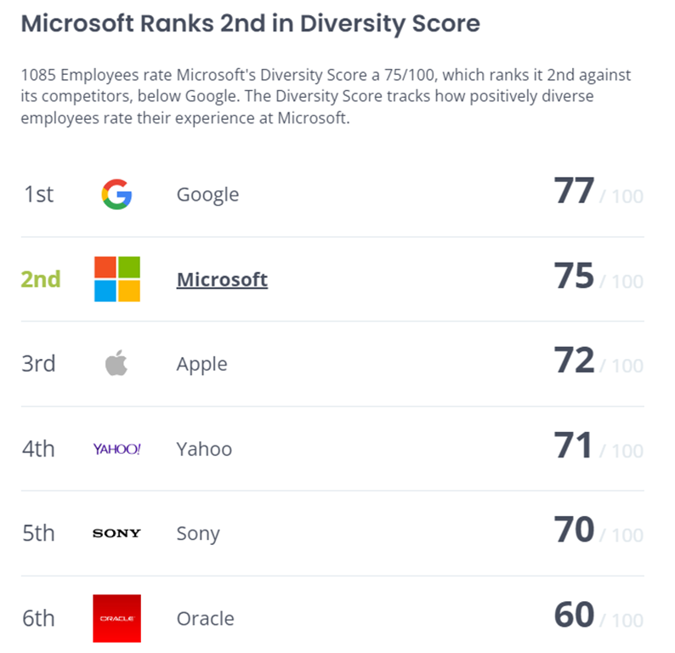


Statistical Data With Respective Of Other Criteria
https://www.comparably.com/companies/microsoft/competitors

Slide 18
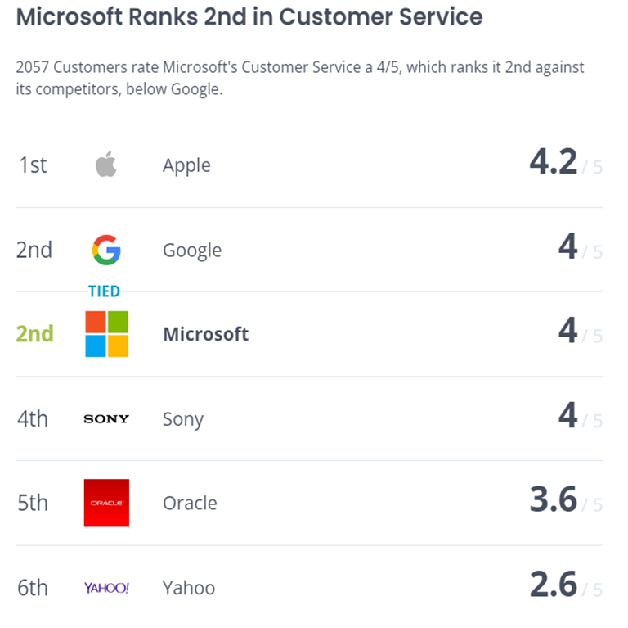
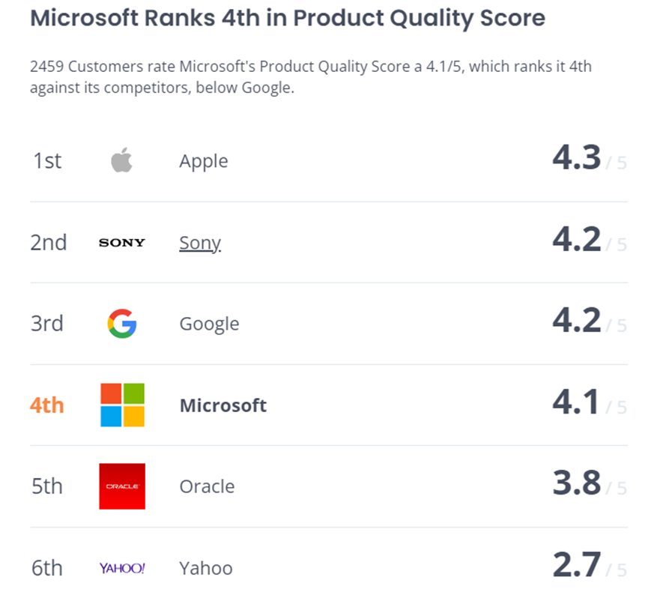

Slide 19
Future Scope
Computer vision
Microsoft is developing AI-powered tools for understanding and analyzing visual data. These tools are being used to improve the accuracy of image and video recognition, the ability of computers to understand and respond to human emotions, and the ability of computers to create realistic and engaging virtual experiences.
AI in Products
The future of every Microsoft product involves AI. For instance, Copilot for Microsoft 365 was introduced to increase productivity and save time. Users have reported significant productivity gains and improvements in the quality of their work.
AI for business
Microsoft is developing AI-powered tools to help businesses operate more efficiently and effectively. These tools are being used to optimize supply chains, improve customer service, and automate repetitive tasks.

Slide 20
Future Scope
Intelligent cloud
Microsoft is developing AI-powered tools that can run on its Azure cloud computing platform. These tools could be used for tasks such as building chatbots, developing predictive analytics applications, and automating business processes.
AI-Powered Automation
Microsoft is working in AI that will automate tasks and processes, freeing up human workers to focus on more creative and strategic endeavors.
AI-powered Healthcare Solutions
Microsoft is exploring AI applications in healthcare, aiming to improve diagnostics, treatment planning, and patient care. For example, AI algorithms can analyze medical images to identify abnormalities and assist in diagnosis.

Slide 21

Conclusion
Microsoft is using AI to make its products and services better, and it is also making AI tools available to everyone. This means that anyone can use AI to solve problems, no matter how big or small their business is. Microsoft is committed to using AI in a responsible way that benefits everyone, and the company is working with businesses and organizations around the world to make AI a force for good.

Slide 22


Thank You

Slide 23
References
Bing chat
Chat GPT
Google Bard
Microsoft
And some research papers.......

